Slide 1
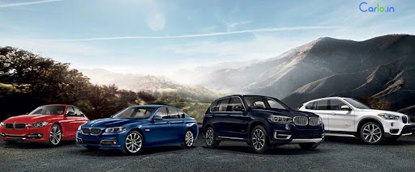
CAR RENATL APPLI
CAR RENTAL APPLICATION
RLL Project - Group 02
Company Name

Slide 2
Team Members : Github Link: https://github.com/dhanush-gangabathina/RLL-Group-2-Car-Rental-Application
Dhorishetti Naveen Kumar - 2584101
Ellaboina Revathi - 2584056
Gangabathina Dhanush Kumar - 2583447
Gayathirideve B - 2583061
Golle Sandhya - 2583625
Gowdacheruvu Kalpana - 2582996
Jagruti Lalit Patil - 2584291
Janga Mahesh Reddy - 2583302

Slide 3
CONTENTS:
Introduction
Abstract
Technologies Used
Environment
Data Flow
Screenshots
J-Unit Testing
Advantages
Conclusion

Slide 4
INTRODUCTION :
Your Car Rental is a car rental service for everyone.
It is user- friendly, thus helping in better utilization of the resources. This project offers the best of services-both in terms of man and machine.
It offers the online car rental service for travel agencies.
It offers the best of rates and include the different categories of cars from luxury to budget.
Our Car Rental service will also provide Accumulate loyalty points for Regular Customers.

Slide 5
ABSTRACT :
The Car Rental System is being developed for customers so that they can book their vehicles from any part of the world. This application takes information from the customers through filling their details. A customer being registered in the website has the facility to book a vehicle which he requires.
Car rental management system is a project which aims in developing a computerized system to maintain all the daily work of Car Rental .
It also has a facility of admin login through which the admin can monitor the whole system . It also has facility of an online notice board where Admin can put up information about the cars available in the exhibition and their prices and updating all data that go through the rental process.
It has also a facility where user after logging in their accounts can see list of cars and its price and Availability of the car.
Overall, this project of ours is designed to help anyone make it easier during the process of renting a car in the best possible way, as well as reducing human efforts and obtaining the best.

Slide 6
Technology Used
HTML : Page layout has been designed in HTML.
SCSS : SCSS has been used for all the designing part.
TS : TypeScript is a primary language for Angular application development.
Java : All the business logic has been written in Java.
Angular CLI : Command-line interface tool that we use to initialize.
MySQL : MySQL database has been used as database for the project.
Hibernate : Used for object table mapping.
Spring-boot : Server side setup.
Post-man : Postman is an API platform for building and using APIs

Slide 7
ENVIRONMENT
Intel hardware machine (PC P4-2.26 GHz, 8GB RAM, 40 GB HDD)
Database – MySQL
MySQL Connector
Node Version 10
JDK 17
Eclipse IDE or Spring Tool Suite
Angular Version 16.2.4

Slide 8
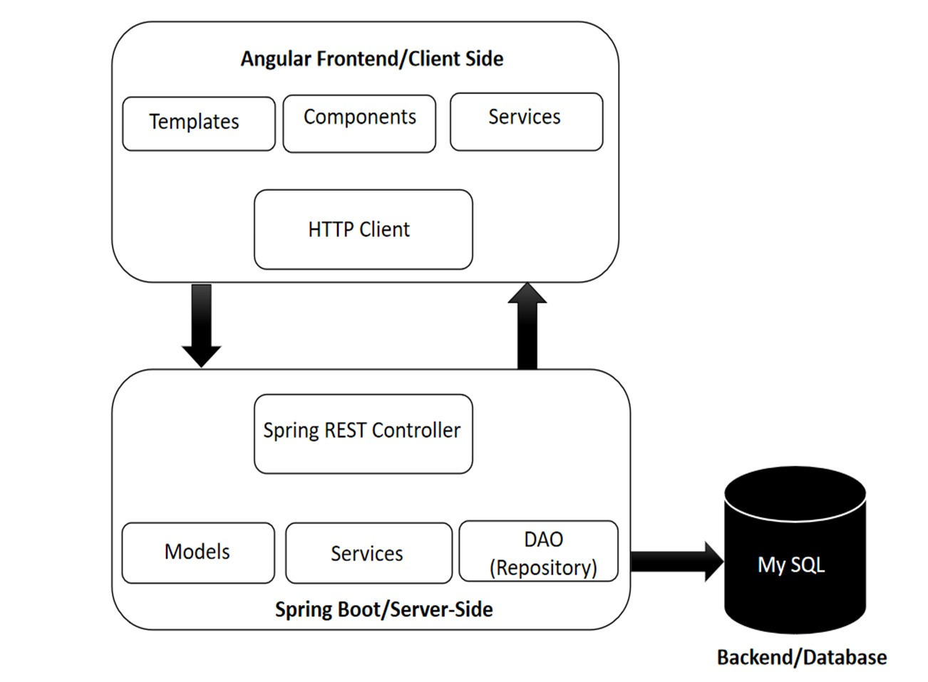
DATA FLOW

Slide 9
ER - Diagram For User
Username
UserEmail
Password
Username
UserEmail
Password
USER
SIGNUP
Email
Password
Captcha
LOGIN

Slide 10
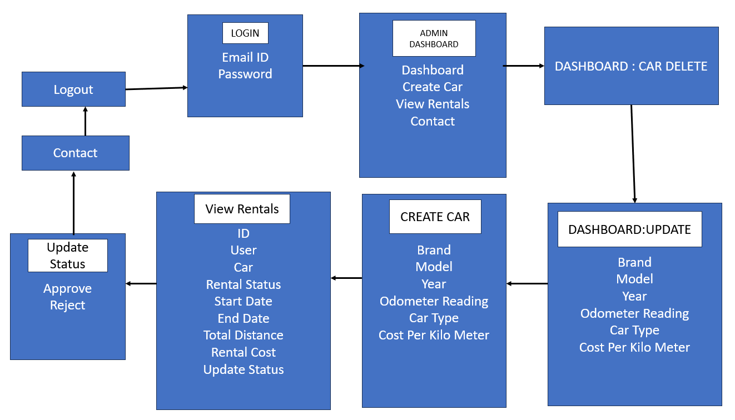
ER Diagram for Admin:

Slide 11
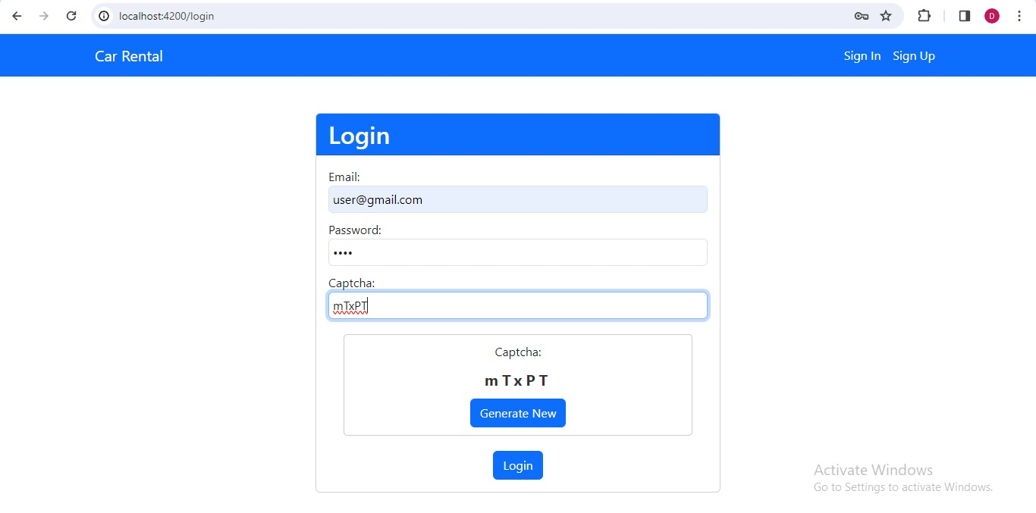
Admin Signin

Slide 12
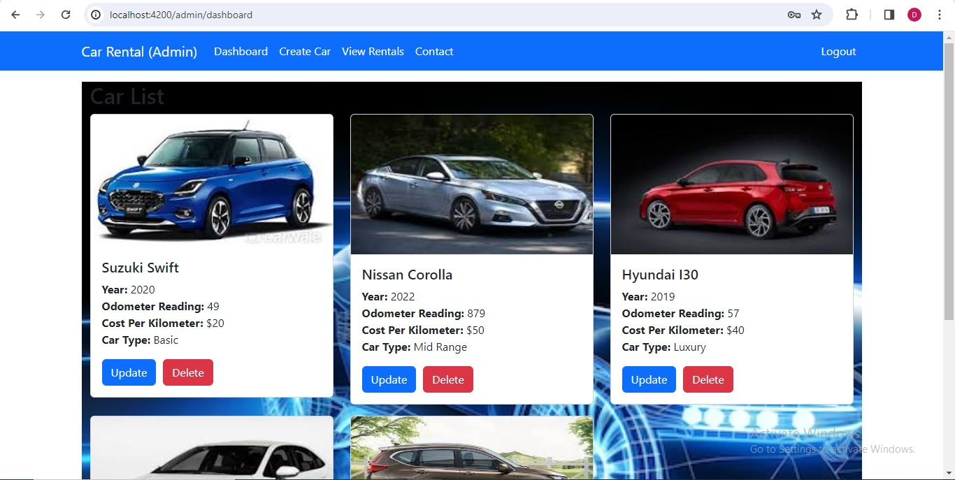
Admin DashBoard

Slide 13
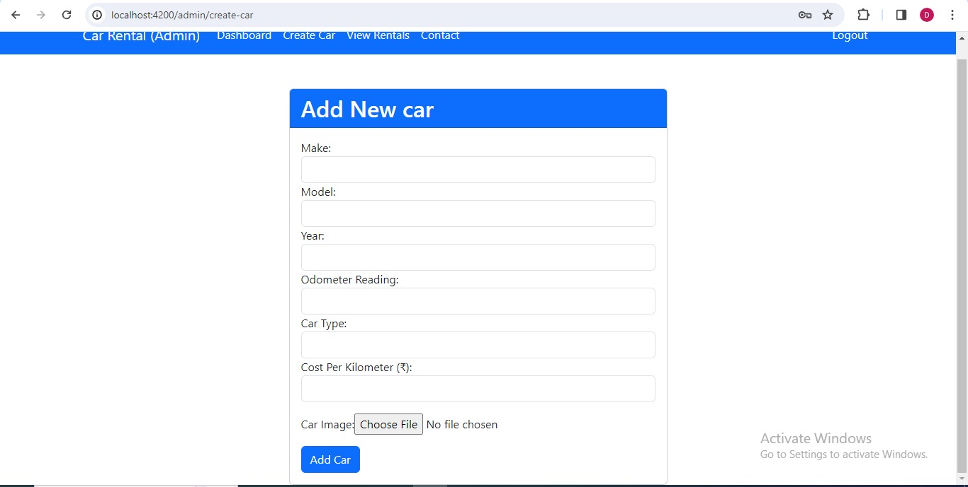
Add New Car In Admin Page

Slide 14
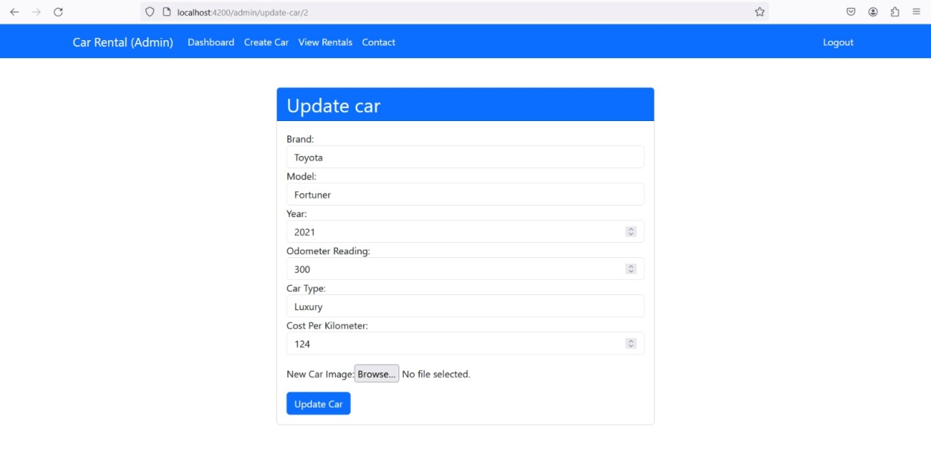
update car:
Manages updating car details in the system. Utilizes form validation for data integrity. Interacts with backend services for CRUD operations. Enhances user experience with dynamic form controls.

Slide 15
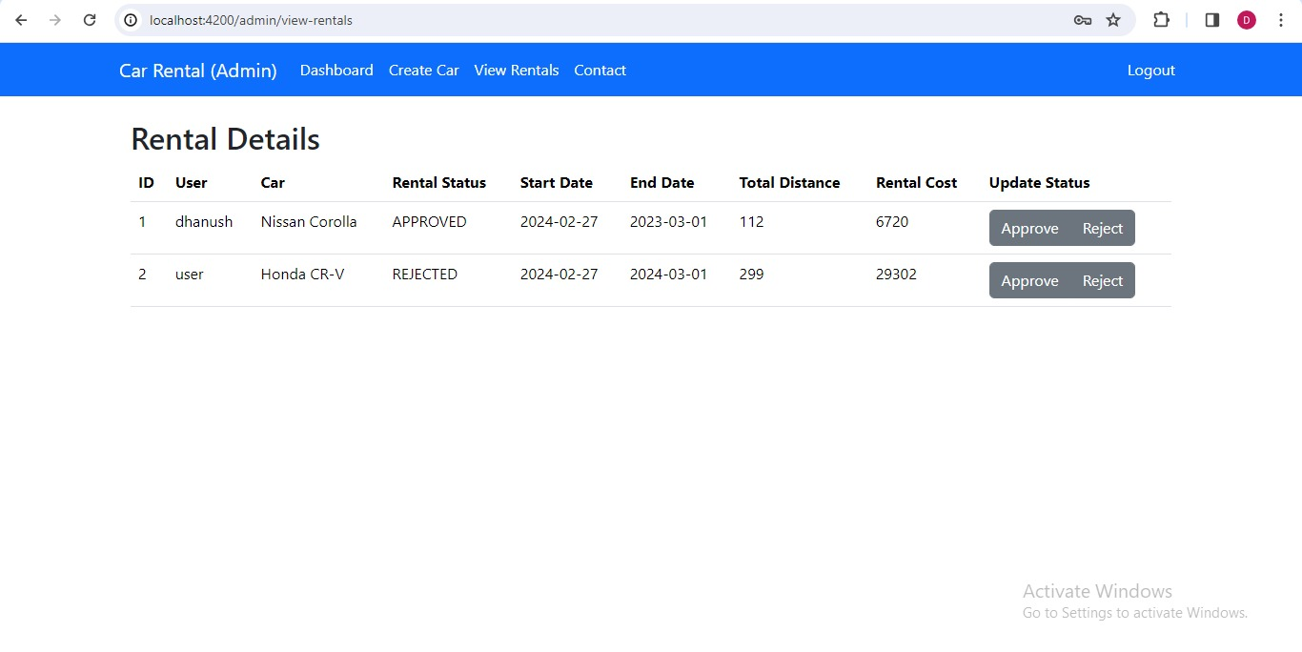
View Rentals of Admin

Slide 16
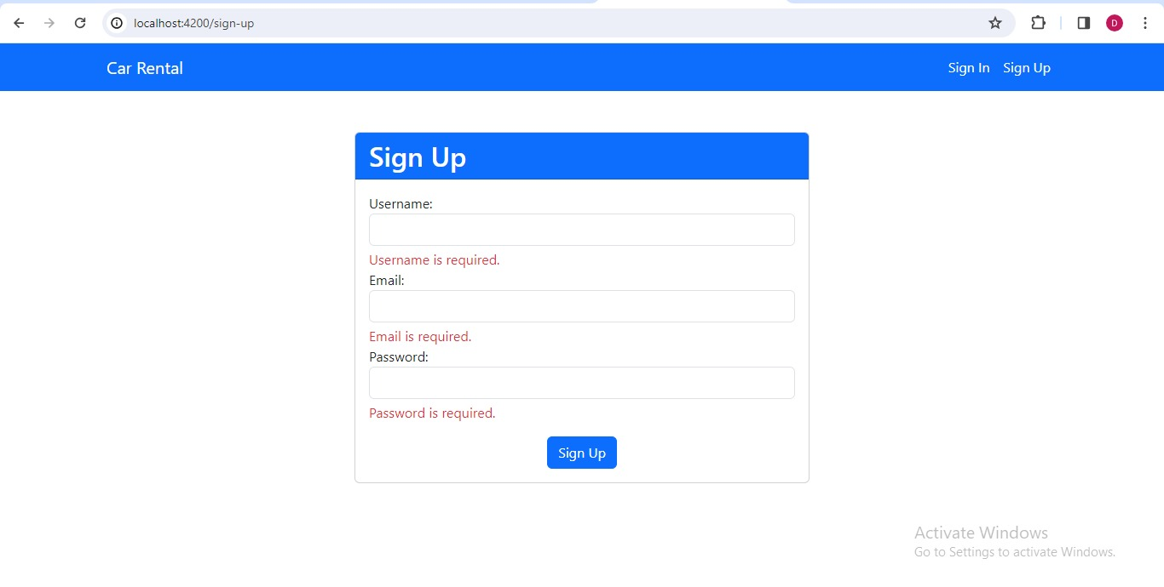
User Signup:
The user module allows users to register, log in, and log out. Users benefit from being able to sign on because this associates content they create with their account and allows various permissions to be set for their roles.

Slide 17
SignIn

Slide 18
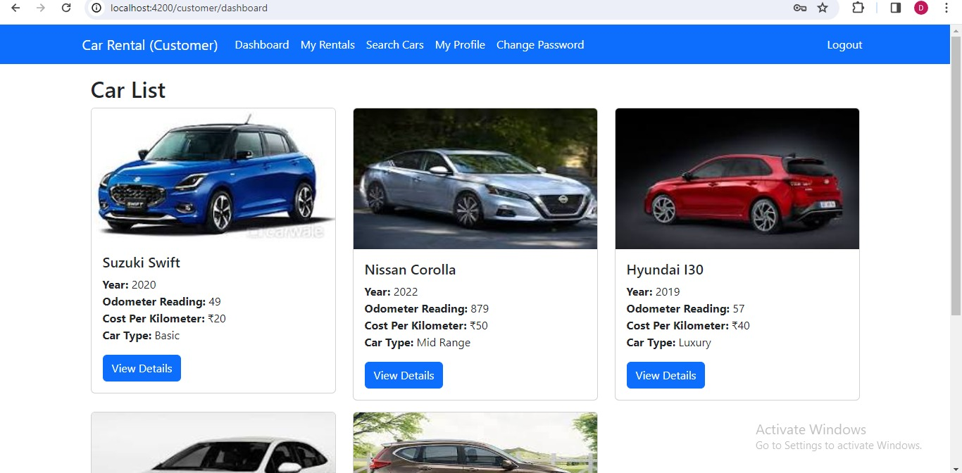
User DashBoard

Slide 19
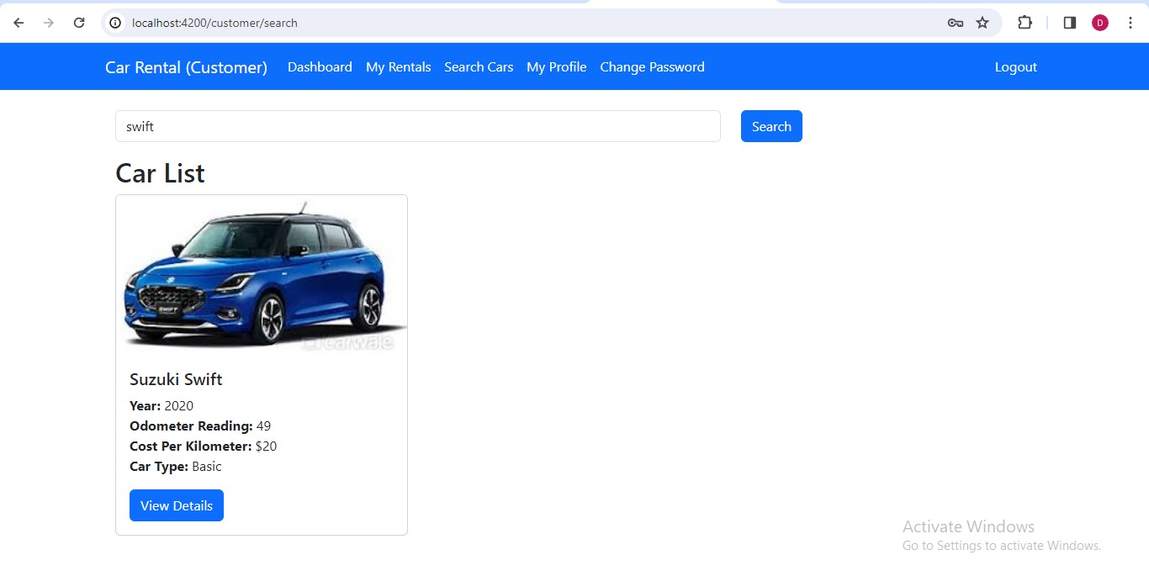
Search Car By Model

Slide 20
View Details of Car and Booking:
In this scenario renting a car, after clicking on view details they should see information such as the year of the car, odometer readings, cost per kilometer, and car type.
When the customer books the car, they need to provide the starting date to rent a car and the ending date of the car rental. The system should also display the odometer starting reading to the customer. After entering all the necessary details, the customer should be able to Book the car.

Slide 21
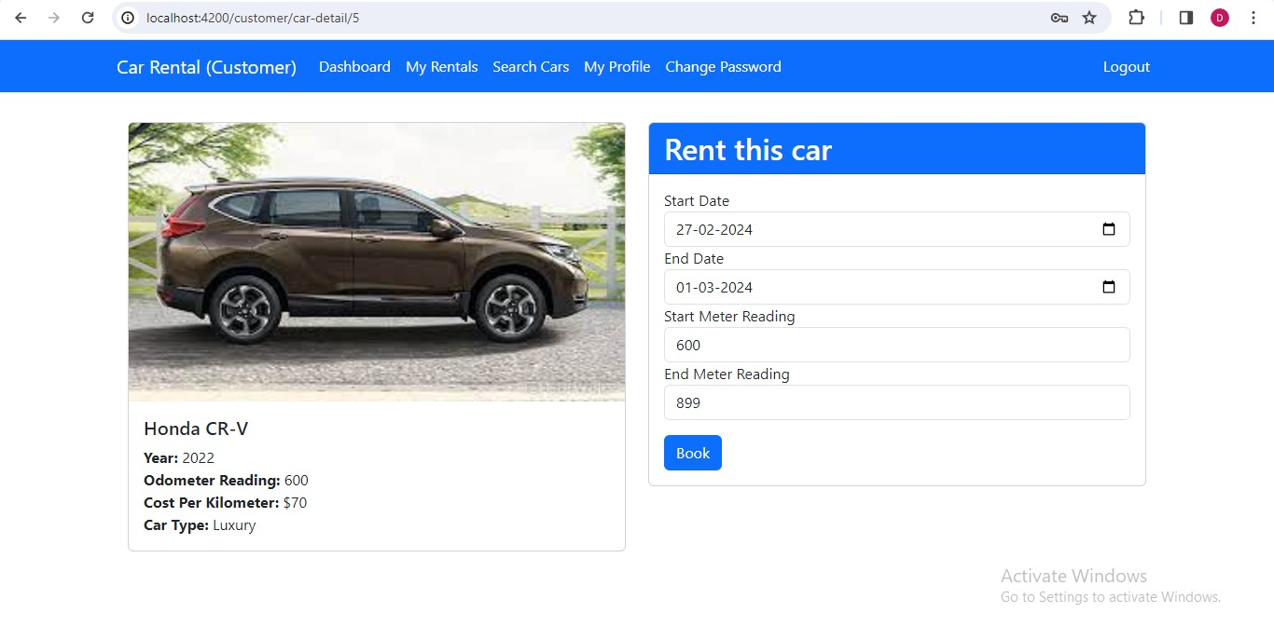
View Details of Car and Booking:

Slide 22
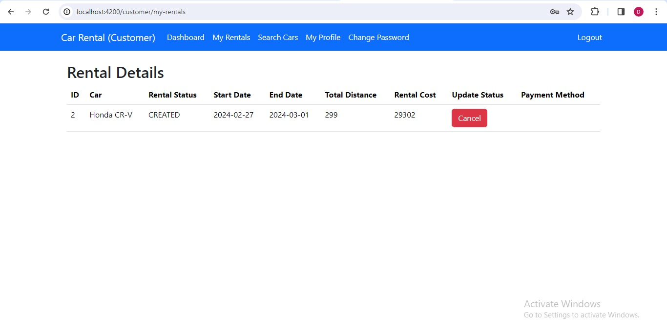
User Rentals

Slide 23
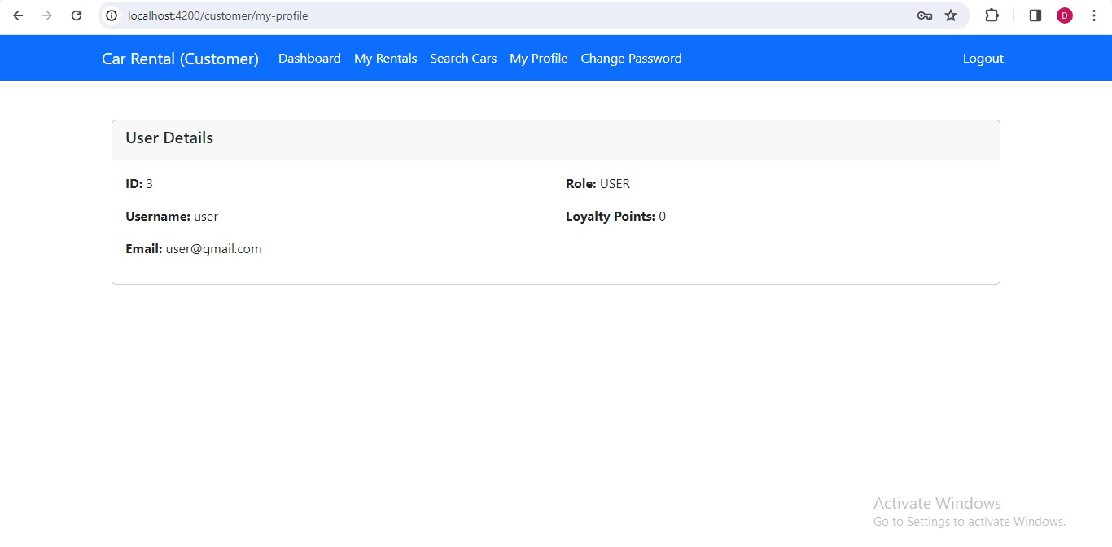
User Profile: The user profile delegation displays the user’s account and demographic information.

Slide 24
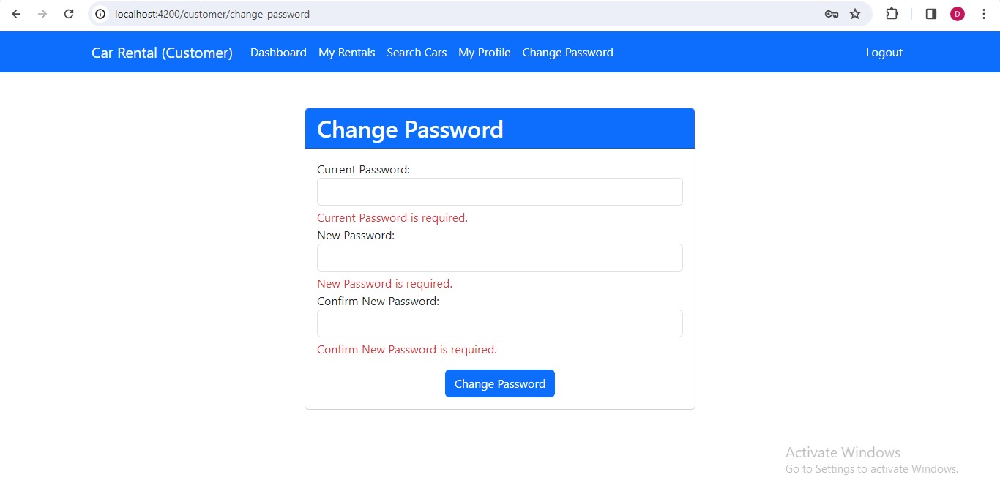
Change Password For User

Slide 25
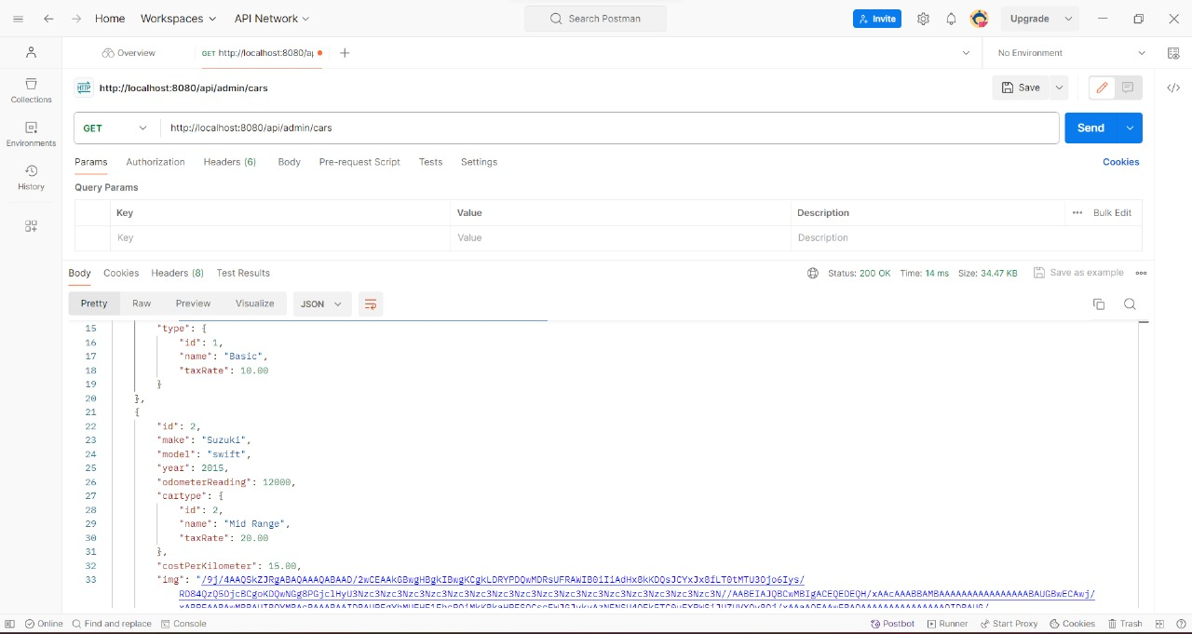
API Testing using Postman: Car Details:

Slide 26
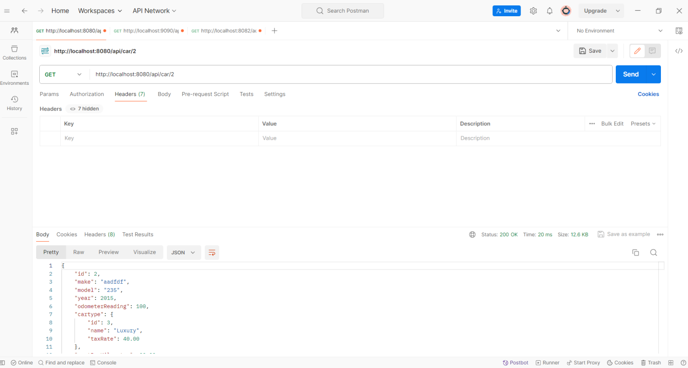
Get Car by Id:

Slide 27
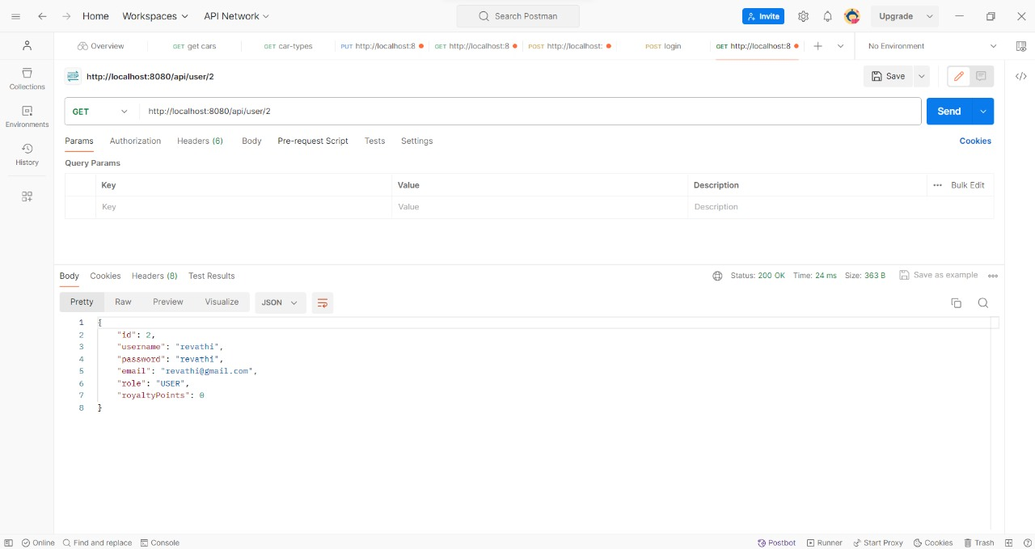
Find User by ID:

Slide 28
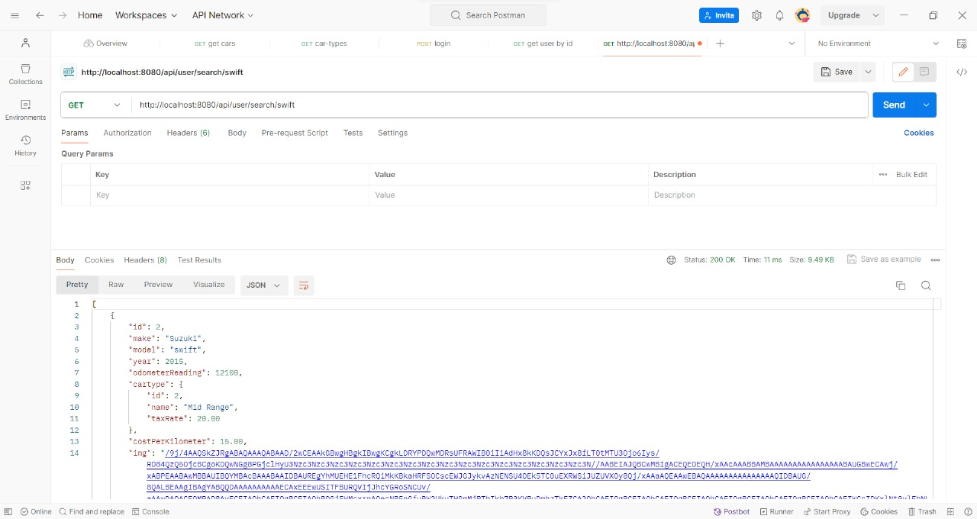
Search Car by Model:

Slide 29
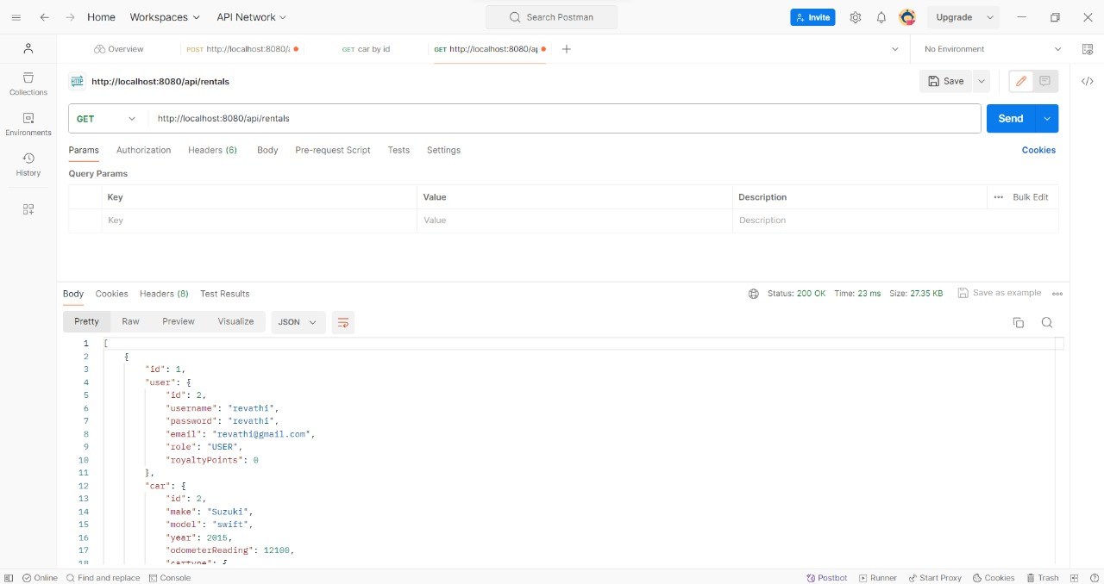
Rentals:

Slide 30
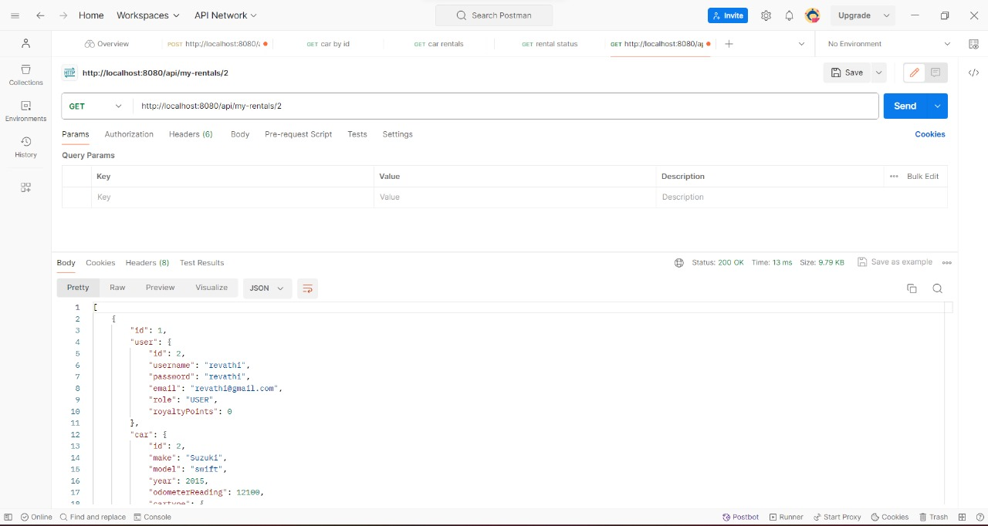
My Rentals:

Slide 31
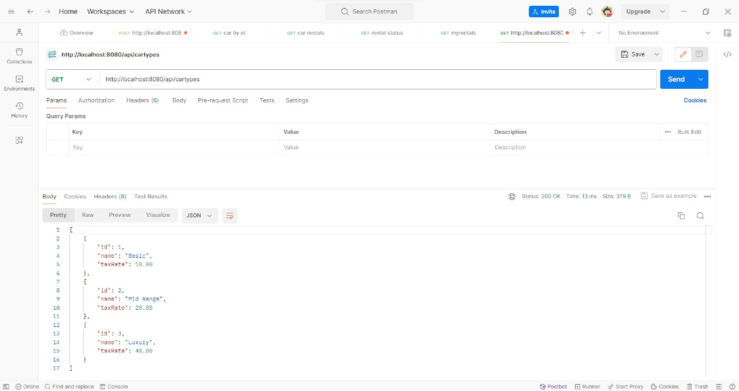
Car Types:

Slide 32
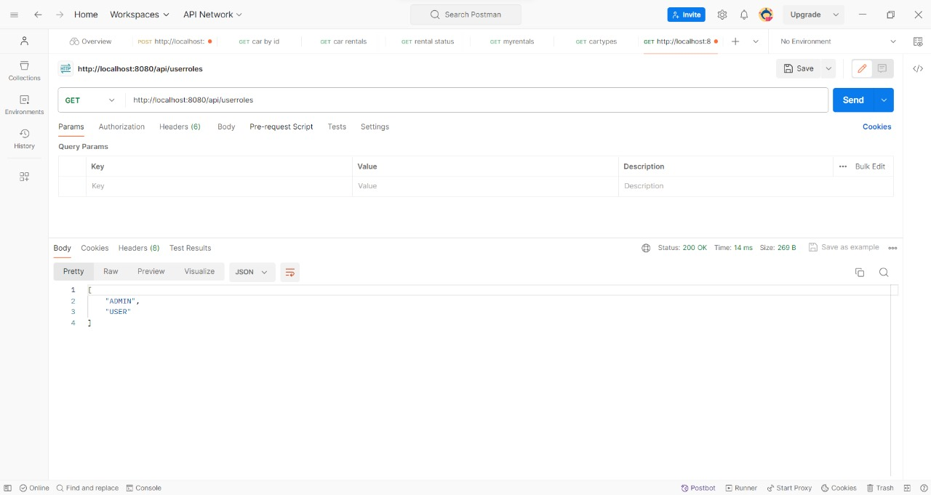
Roles:

Slide 33
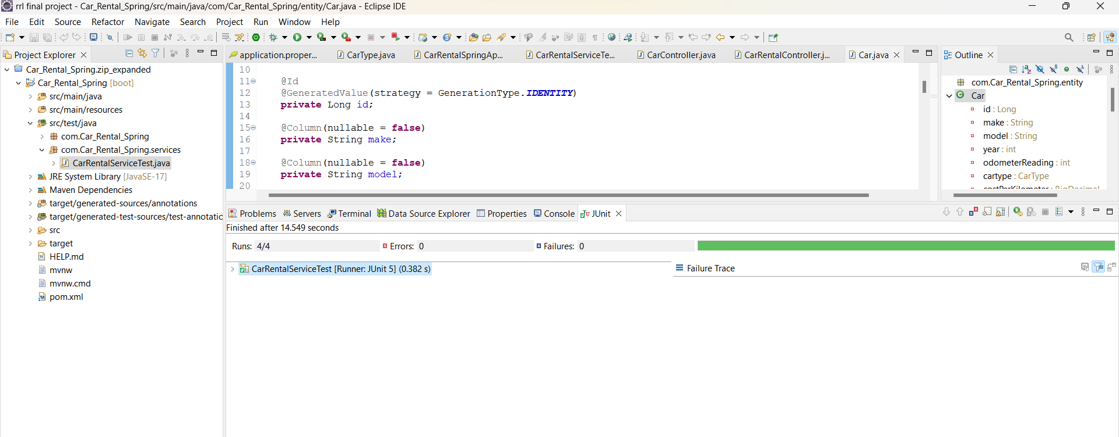
J-Unit Testing

Slide 34
Advantages
Convenience: Customers can easily search for available cars, make reservations, and complete bookings directly from their smartphones or computers. This convenience saves time and effort compared to traditional methods of renting a car.
24/7 Availability: Users can make reservations and rent cars at any time of the day or night, as these applications are available 24/7, offering flexibility to users with varying schedules.
Transparent Pricing: Users can see the total cost of renting a car upfront, including taxes, fees, and any additional charges, which helps them make informed decisions and avoid surprises at the time of payment.
Customer Support: Users can access customer support services through the application in case of any issues or concerns during the rental period, ensuring a smoother experience overall.
Loyalty Programs and Discounts: Our car rental application offer loyalty programs, discounts, and rewards for frequent users, encouraging customer retention.

Slide 35
CONCLUSION
The website is designed to stay up to date by giving administrators the ability to update/add/delete cars on the site.
The website will store information the user may input when making a rental purchase request.
This software provides an easy-to-use interface to allow for simple access to rental requests and Customer information.
"Car Search and Display" feature offers a seamless and intuitive experience for users to browse and select from our car inventory.

Slide 36


